Slide 1
<Network project/>
<Name: KUBEKA B.S/>
<Student no: 217010763/>

Slide 2
Problem STATEMENT
JetPrint is a company that provides printing and embroidery services for their clients and have been struggling with printing images.
In order to successfully provide these services, they require software tools to help them.
They’ve approached me to assist them with an application that’ll allow them to edit pictures the simplest way possible.

Slide 3
Solution
The goal, for this project is to provide software tools to a printing business that sells prints that can be customized with digital images.
To accomplish this function, a photo editor Application must be used by a user from JetPrint computer’s.
The user can modify images, adding graphics, and special effects, Then the user can save the altered photos on their local computers and then upload the images.

Slide 4
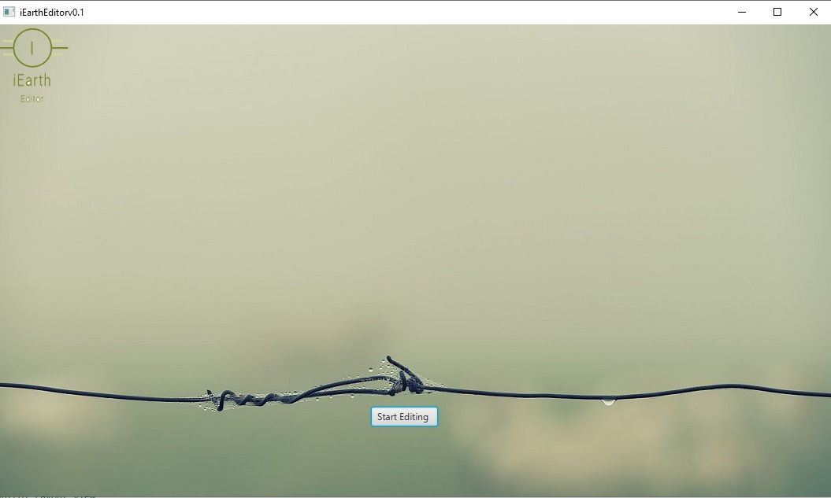
Methodology
Click this button to start
editting

Slide 5
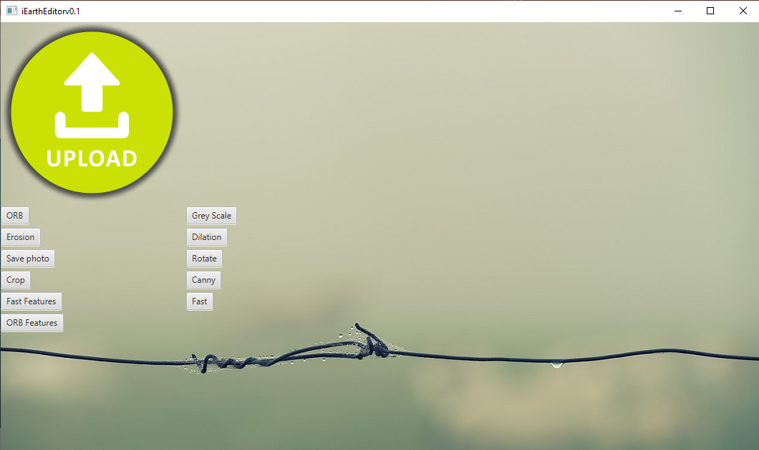
Methodology
Click on icon to
Upload desired
image
Button for each
Edit type for the
uploaded image.
To change Image click
On It.
Choose the best workable solution and create a plan to build a prototype
What materials will you use for your prototype?
Will your prototype be actual size or a model? Why?

